Slide 1
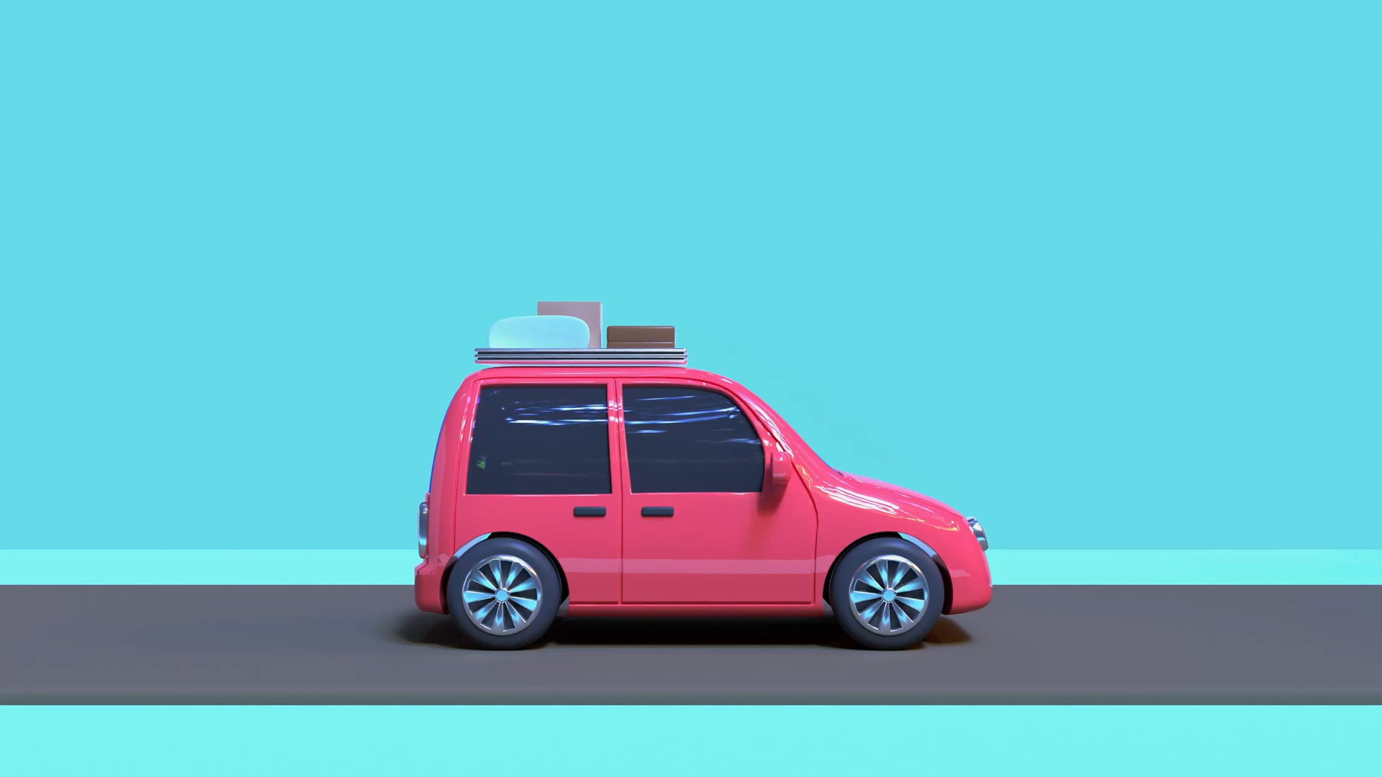
Car Rental System in Docker
Yoobee Colleges

Slide 2
Outline
Prerequisites
Project Structure
Example App Functionality
Dockerfile Setup
Build and Run Commands
Persist Database (Optional)
Common Issues & Fixes
Activity
Next Steps
Notes:
Help:
1) Install what you need (on your computer)
Docker Desktop: install from docker.com, then open it.
(Optional) Python if you want to test locally, but not required for Docker.
Note: SQLite comes with Python; nothing extra to install inside the container.
2) Unzip the project
Unzip car_rental_starter.zip somewhere convenient, e.g. ~/car_rental (Mac/Linux) or C:\car_rental (Windows).
Inside you’ll see:
car_rental/
├─ app.py # CLI program (add/list/remove cars)
├─ Dockerfile # Docker build instructions
├─ requirements.txt # (empty; sqlite3 is stdlib)
└─ .dockerignore
3) Build the Docker image
Open a terminal in the project folder and run:
docker build -t car_rental .
This creates an image named car_rental.
4) Run the app (interactive)
Run the container with a terminal attached:
docker run -it --name car_rental_app car_rental
You’ll see a menu:
Car Rental System
1. Add Car
2. List Cars
3. Remove Car
4. Exit
Choose:
Use it to add, list, and remove cars (by plate, type, year).
A SQLite database file cars.db is created inside the container.
To stop: choose 4 (Exit) or press Ctrl+C.
To run it again later:
docker start -ai car_rental_app
5) Persist the database on your computer (recommended)
If you want the cars.db file saved outside the container, mount it as a volume:
macOS / Linux (bash/zsh):
docker run -it --rm -v $(pwd)/cars.db:/app/cars.db car_rental
Windows PowerShell:
docker run -it --rm -v ${PWD}/cars.db:/app/cars.db car_rental
Windows cmd.exe:
docker run -it --rm -v %cd%/cars.db:/app/cars.db car_rental
Now the DB lives next to your project folder and survives container rebuilds.
6) Common commands & tips
Rebuild after changes:
docker build -t car_rental .
See running containers:
docker ps
See all containers:
docker ps -a
View logs:
docker logs car_rental_app
Remove the container:
docker rm -f car_rental_app
7) What’s installed inside Docker?
Base image: python:3.12-slim
Python standard library (includes sqlite3), so no extra packages needed.

Slide 3
1. Prerequisites
Install Docker Desktop (Windows/Mac/Linux)
Optional: Python 3 (test locally before Dockerizing)
SQLite3 comes with Python – no extra install needed

Slide 4
2. Project Structure
app.py → main Python program (Add/List/Remove cars)
Dockerfile → instructions to build Docker image
requirements.txt → dependencies (empty for now)
cars.db → SQLite database (auto-created)

Slide 5

3. Example App Functionality
Add a Car → Plate, Type, Year
List Cars → Show all stored cars
Remove Car → Remove using plate number
Exit → Quit the program

Slide 6
4. Dockerfile Setup
FROM python:3.12-slim
WORKDIR /app
COPY . /app
RUN pip install -r requirements.txt || true
CMD ["python", "app.py"]

Slide 7
5. Build and Run Commands
Build image → docker build -t car_rental .
Run app → docker run -it --name car_rental_app car_rental
See menu inside container:
1. Add Car 2. List Cars 3. Remove Car 4. Exit

Slide 8
6. Persist Database (Optional)
Use volume mounting to save DB outside container
Linux/Mac: docker run -it -v $(pwd)/cars.db:/app/cars.db car_rental
Windows (PowerShell): docker run -it -v ${PWD}/cars.db:/app/cars.db car_rental
Now data survives rebuilds and container restarts

Slide 9
7. Common Issues & Fixes
No such table → run app once to create table
Duplicate plate error → use unique plate numbers
Permission denied on cars.db → fix file permissions
File not found → check app.py is copied into image

Slide 10
8. Next Steps (Activity)
Experiment by adding more features (search, update cars)

Slide 11
Future Learning
Learn to expose a REST API with Flask or FastAPI
Deploy app to cloud (AWS, Azure, GCP)

Slide 12

Q&A

